Slide 1
Scrum-agile and Waterfall presentation
Rachel Aldava
Southern New Hampshire University
CS-250-J7704
Eugenio Rodriguez
15 April 2023

Slide 2

Scrum Team Roles
Product owner
    The product owner interacts with the client and represents the client’s vision by creating and prioritizing user stories.
Scrum master
    The scrum master’s role is to provide team leadership, to facilitate scrum events, and to ensure that each team member is free of impediments.
Development team
  The development team collaborates during scrum meetings in order to delegate user stories, implement them, and test them. Teams may identify sub-roles such as tester, however under Scrum-agile, the entire team remains responsible and involved for all stages of development.
  (Coursera, 2022)

Slide 3
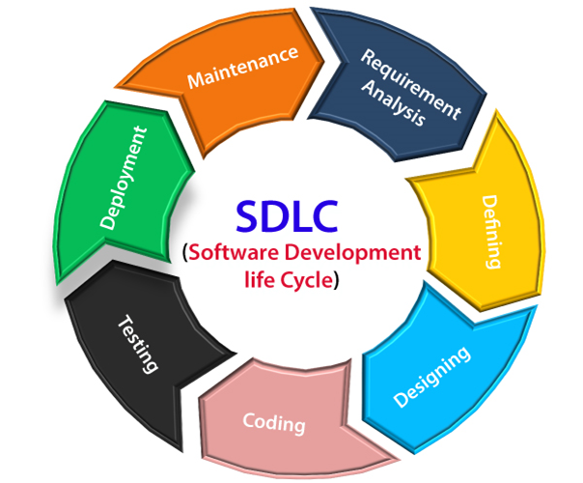
Software Development Lifecycle (SDLC)
Requirement analysis
  The product owner and team meet with team to discuss the nature of the product they are requesting
Defining
  The product owner and team formulate a list of software requirement specifications which the stakeholders can agree to
Designing
  The team coordinates with the product owner to determine how specifically the software will be designed
Coding
  The product owner prioritizes user stories and the team self-organizes the work of creating the product
  with the assistance of the scrum master
Testing
  The team tests the product in order to ensure that it aligns with the software requirements and
  specifications
Deployment
  After the product passes testing, the stakeholder will start using the product
Maintenance
  Once the product is in use, the stakeholder may identify issues with the product or ideas for further
  improvements; the cycle loops.
  (Javapoint, 2023)
  c

Slide 4
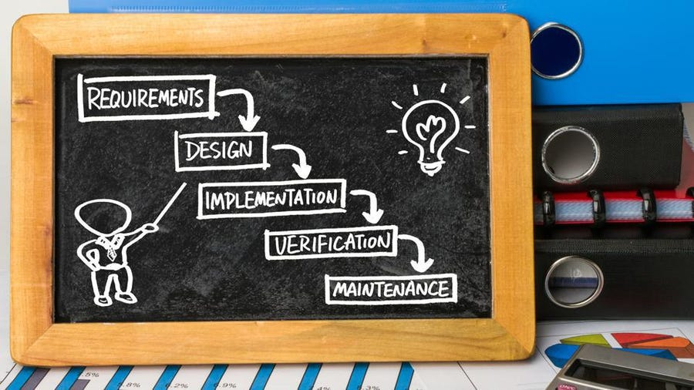
How it looks in waterfall
The hallmarks of the waterfall model feature front-loaded planning and requirement agreement prior to any development.
The SDLC is linear rather than circular and has a definite end point
Due to its linear nature, accepting a change in requirements would
push back the release date and add to the workload of specific team
members.
The other possible business decision would be to refuse the change
requirements (which could have financial implications)
(Hoory, 2022)

Slide 5
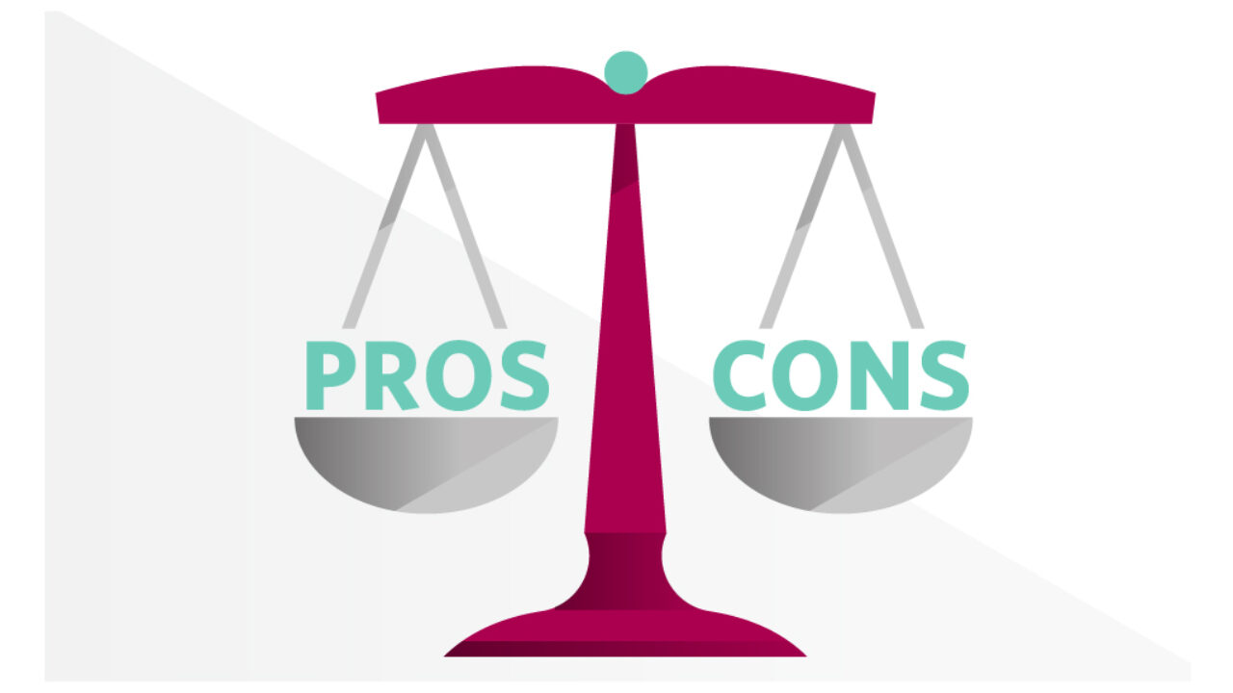
Which is better when?
The waterfall method’s linear planning is good for predictability.
  It is useful for when you have a fixed budget or release date.
  It is necessary when iterative testing is impossible.
The Agile method’s flexible approach is good for adapting to change.
  It can deliver product quickly and efficiently
  It can allow clients more opportunity for feedback
  It can easily adapt to changes in specification
  (Chandana, 2023)

Slide 6
Works cited, APA
Coursera. (2022). The 3 Scrum Roles and Responsibilities Explained. Coursera.
https://www.coursera.org/articles/scrum-roles-and-responsibilities
SDLC - software development life cycle - javatpoint. www.javatpoint.com. (n.d.). Retrieved April 16, 2023, from https://www.javatpoint.com/software-engineering-software-development-life-cycle
Chandana. (2023, April 7). Scrum project management: Advantages and disadvantages. Simplilearn.com. Retrieved April 16, 2023, from https://www.simplilearn.com/scrum-project-management-article

